Slide 1
HP Loadrunner vs. JMeter
September 2016

Slide 2
This document draws a comparison of HP Loadrunner and JMeter based on the following criteria to demonstrate the value of choosing HP Loadrunner over JMeter as recommended load testing tool solutions for Sunnybrook:
End user performance experience measurement
Test script development & maintenance
Scalability

Slide 3
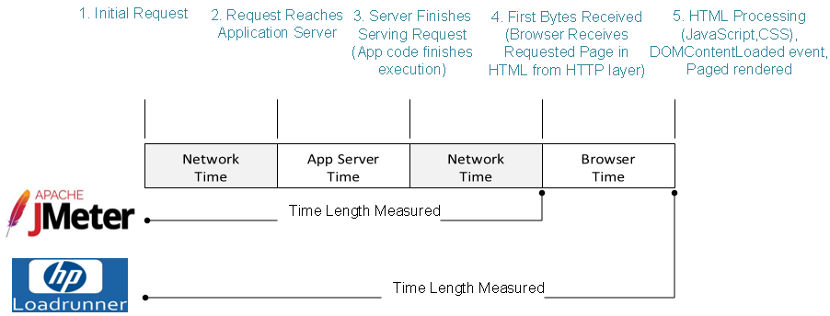
I. End-user Performance Experience Meaurement
JMeter: offers web-based traffic simulation by creating HTTP requests to server and processing server’s responses. It only measures application server time (e.g. time for application code execution) + network time
HP Loadrunner: offer web-based traffic simulation using a true browser client. It measures end-user performance experience: server time + network time + browser client time

Slide 4
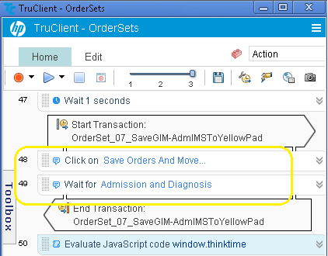
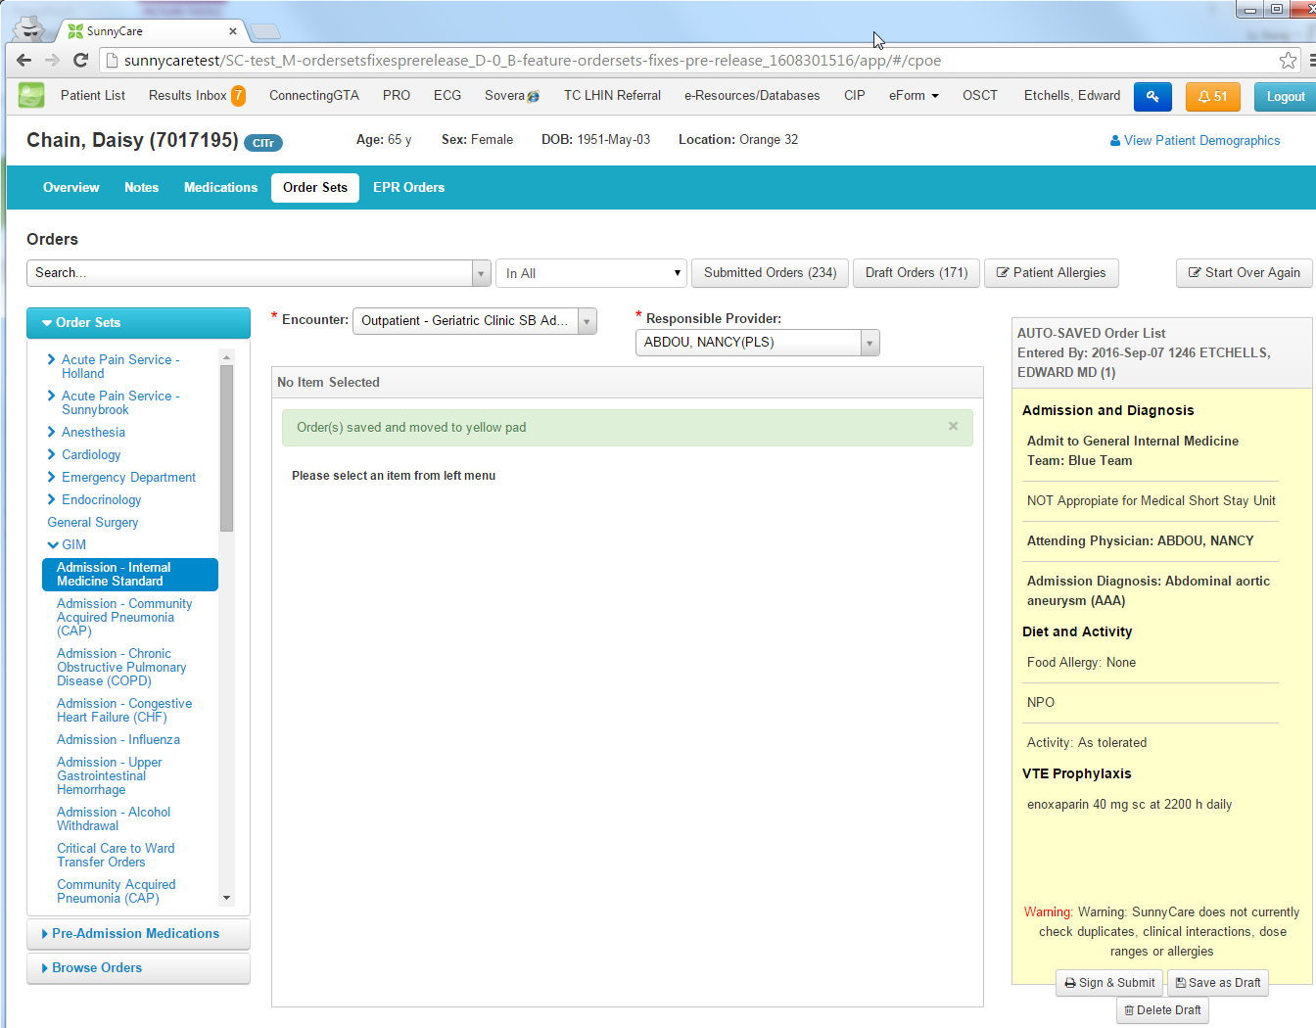
II. Test Script Development & Maintenance
JMeter: works in HTTP. This means test scripts need to work out the dynamical values returned from server responses that are used in building later HTTP requests. (we call this “correlation” - will explain this in details in next slide)
HP Loadrunner: works on browser and no correlation is required.
A snippet of HP Loadrunner test script for automating “Saving a GIM Orderset to Yellow Pad”:
HP Loadrunner works on browser and the scripting engine is embedded within the browser, and behaves like a true browser client

Slide 5
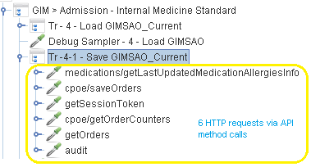
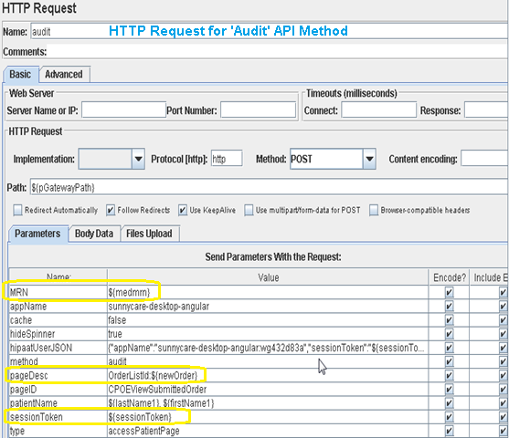
II. Test Script Development & Maintenance
A snippet of JMeter test script for automating “Saving a GIM Orderset to Yellow Pad”:
“Save order to Yellow Pad” consist of 6 HTTP calls
Each HTTP request needs to be submitted with ‘correlated’ values in field parameters to form a valid request:
  capture those values issued from the server in previous server HTTP response
  submit later requests with those captured
  value issued by server
Correlation candidates in ‘Audit’ HTTP request are:
  “pageDesc”: OrderListId:4780
  “sessionToken":38BFD3C612E9BBDDE2739FBC4DC352F6
  And more …

Slide 6

II. Test Script Development & Maintenance
HP Loadrunner provides acceleration in test script development & less maintenance time over Jmeter
Table below demonstrates the comparison of time spent between JMeter and HP Loadrunner among different scenarios:
Scenarios | JMeter | HP Loadrunner
New test case
Existing test case working with continuous application code change (non-UI related) |  | half of
Existing test case working with continuous application code change (UI related)
Existing test case working with same application code deployed in different environment |  | half of

Slide 7
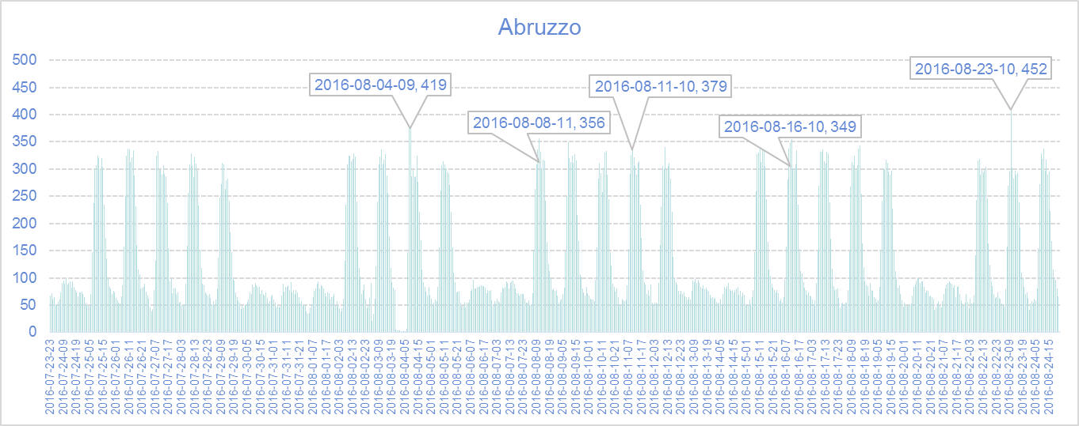
III. Scalability
Requirements: Figure below demonstrates the number of distinct client IP address associated with all requests made to ‘Abruzzo’ node in SunnyCare PROD vs. time (in hour unit) from July 23th to Aug 24^{th (*)}:
  The max number of distinct client IPs that making requests to SunnyCare ‘Abruzzo’ occurred at 10 am in Aug 23rd: there were a total 452 distinct IPs making requests to SunnyCare Abruzzo during that peak hour
* Based on the analysis of Fusion Reactor logs

Slide 8
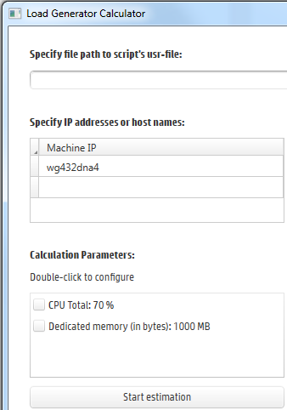

III. Scalability
In order to simulate hourly 452 distinct clients (or 452 user counts with an assumption of 1 user vs. 1 IP address), load testing tools must provide confidence in their scalability level to support this type of large user base testing:
  The scalability of JMeter comes down to the Java JVM’s performance as JMeter is top-to-bottom written in Java. But we need to figure out the following…
    How many virtual users per JVM?
    How many JVM required?
    What hardware specs and how many? (in terms of CPU, Memory, network bandwidth, and etc.)
    All above questions are unknown with JMeter open source based platform
  In contract to Jmeter, HP Loadrunner has the advantage of being a commercial tool both in terms of current & future technical support for scalability
  Feature 1 - Load Generator Calculator
Feature 2 - StormRunner, the future state of HP Loadrunner to allow extend tools scalability in cloud

Slide 9
And more:
JMeter | HP Loadrunner
Open source Support extended libraries in form of plugins Cross platform requires JRE and easy to deploy Insufficient tools for Analysis and Reporting Scripts base on Java language Not equipped with tools for real time monitoring Does not support variable connection speed/bandwidth throttling and network latency simulation It can be used for some functional testing as well | Proprietary software licenced to HP with service support Provides Strong tools for Analysis and Reporting (MS Word, HTML etc.), graphs can be personalised Scripts based on C, VB, Java, Javascript language Lived native real time monitoring for OS with extended graphs for server side performance Supports variable connection speed/bandwidth throttling and network latency simulation Support mobile testing Fully integrated with the most APMs in the market

